Slide 1
Agile Project Management System
OPIM 5272 - Business Process Modeling
& Data Management
Team 8
Date : 12/03/2022

Slide 2

Agenda
Introduction
Results
Swimlane As-Is
Swimlane To-Be
Entity Relationship Diagram
Reports
Q&A

Slide 3
INTRODUCTION AND RESULTS

Slide 4
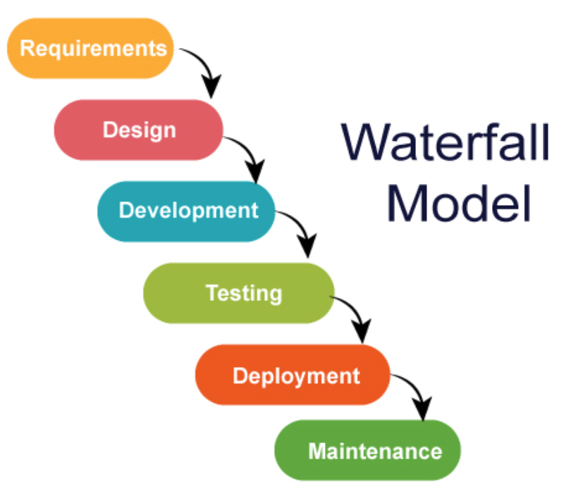
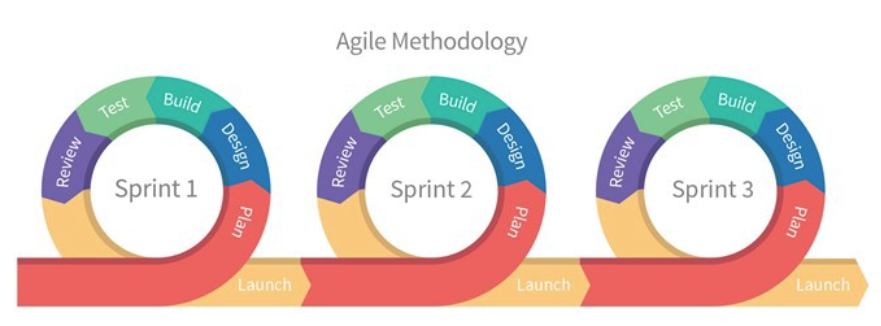
Introduction
Objective - Fulfill client requests in an agile work environment.
Why not traditional work model? Drawbacks :
Making changes is difficult
End user is not involved throughout the process
Testing is delayed until after completion
What is agile and why do we prefer it?
An iterative approach to project management. Teams deliver work in small increments. Requirements, plans, and results are evaluated continuously. Benefits:
End user/ Customer satisfaction
Increased flexibility
Better control
Reduced risks
Continuous improvement

Slide 5

Results
Agile emphasizes on producing results and optimizing performance.
It supports metrics that :
Help measure the team’s performance
Identify bottlenecks
Make data-driven decisions to correct them.
In our project, these metrics help us understand our processes better.
Understand if the work is proportionally divided in the team. The tickets can be moved around if there is a large scale of disproportion.
Identify the progress of each task and understand if the client request will be completed in time.
Determine tasks in the backlog and hold discussions when necessary to establish timelines.
We will explore this further in our slides.

Slide 6
SWIMLANE DIAGRAMS

Slide 7
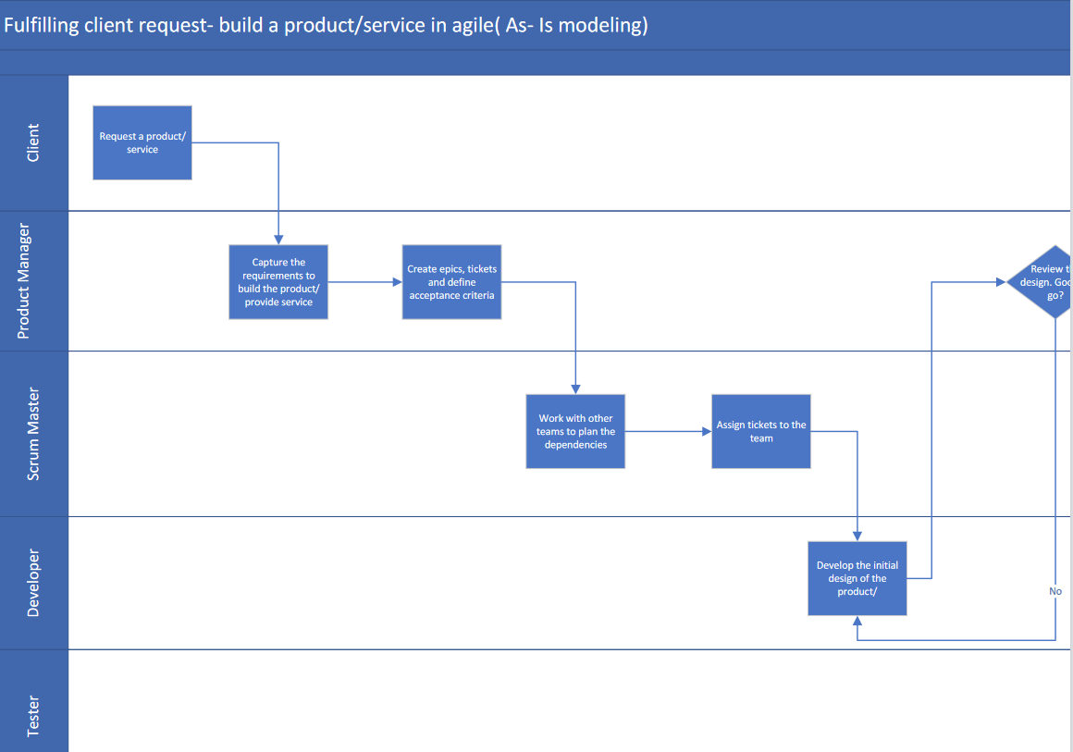
Swimlane As-Is (1 /3)

Slide 8
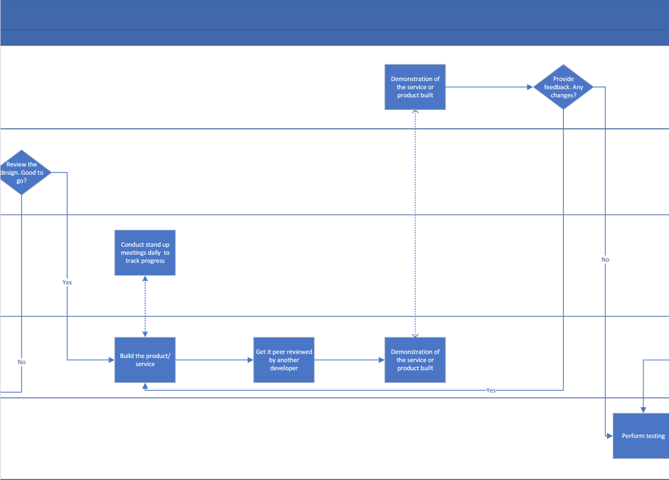

Swimlane As-Is (2 /3)

Slide 9
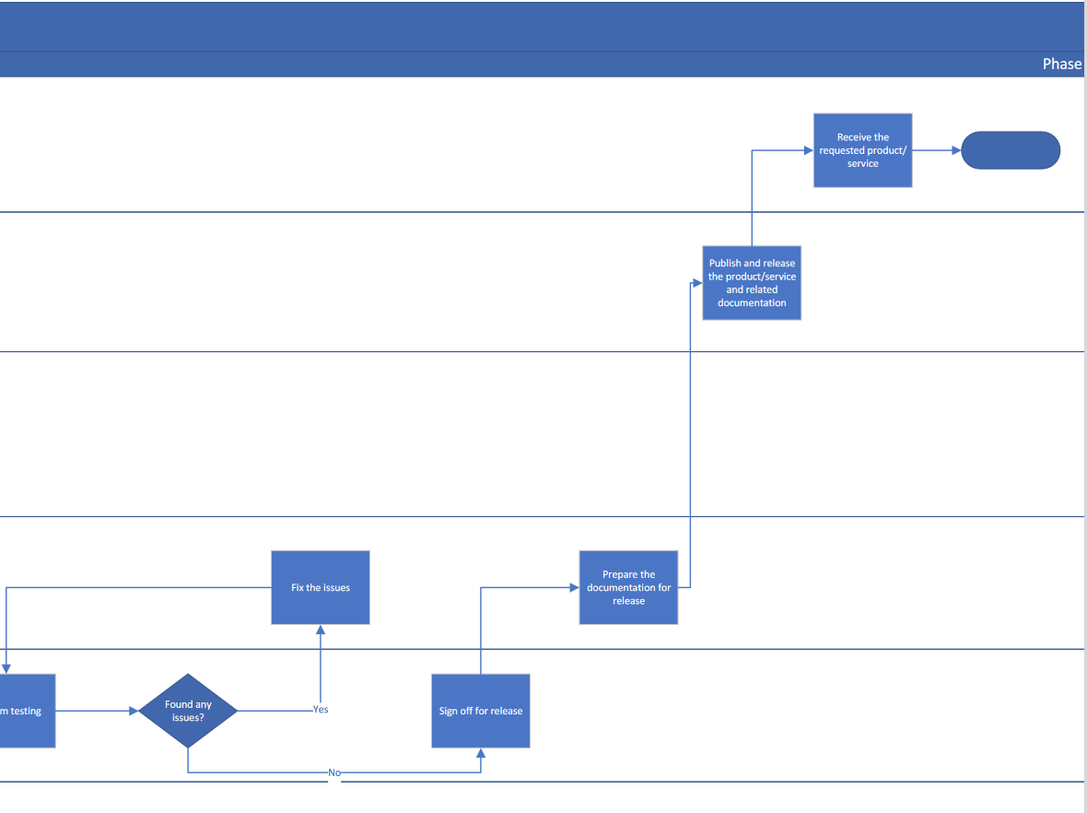
Swimlane As-Is (3 /3)

Slide 10
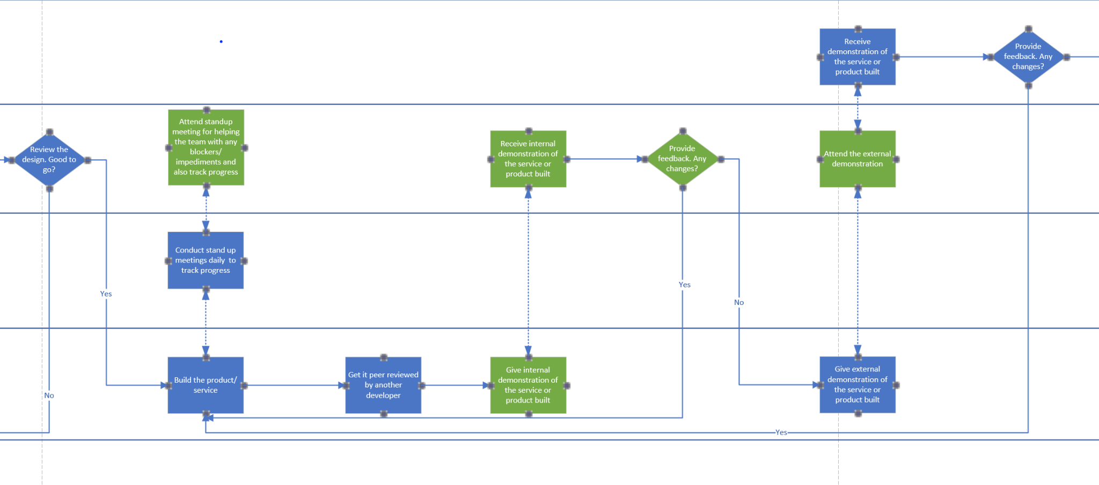
Swimlane To-Be

Slide 11
ENTITY RELATIONSHIP DIAGRAM

Slide 12
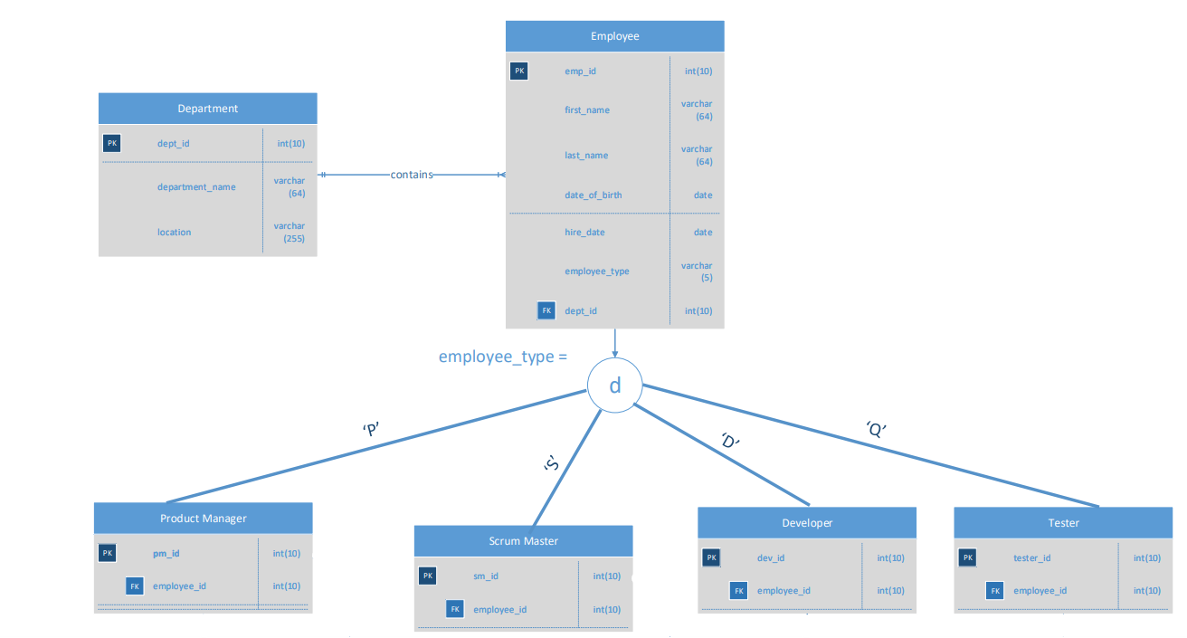
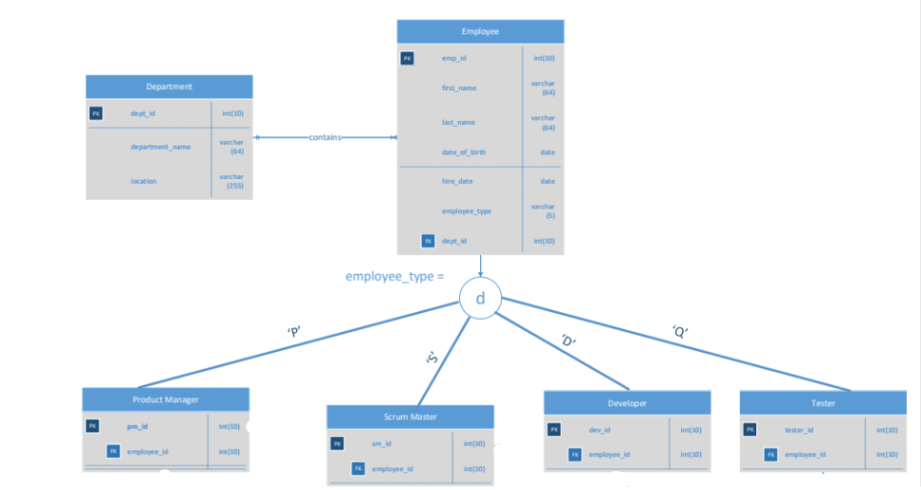
Entity Relationship Diagram

Slide 13
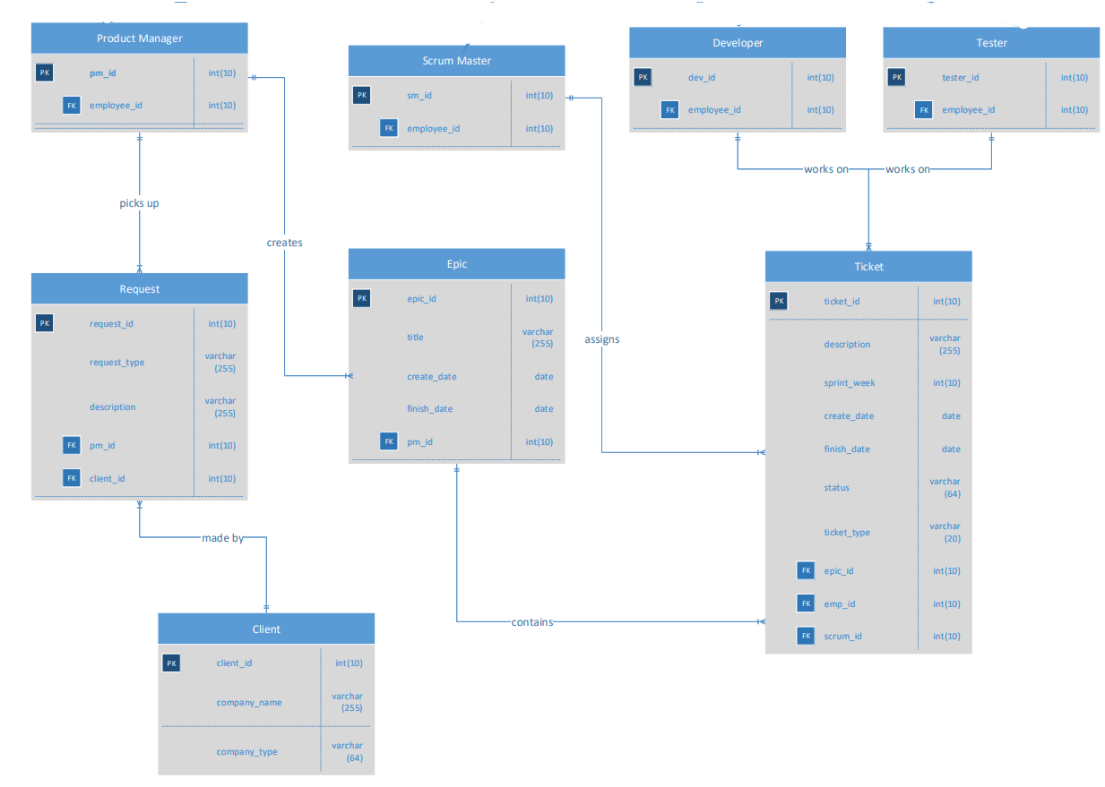
Part - 2

Slide 14
REPORTS

Slide 15

Reports
Inquiries to get information on :
Average length of employment years in each department.
Type of businesses with number of requests for our company.
Tickets that are in the product backlog and the scrum masters
associated with those tickets.
Number and percentage of tickets assigned to developers and testers.
Percentage of tickets of each type under the epics, their details
and the information of the associated product manager.

Slide 16
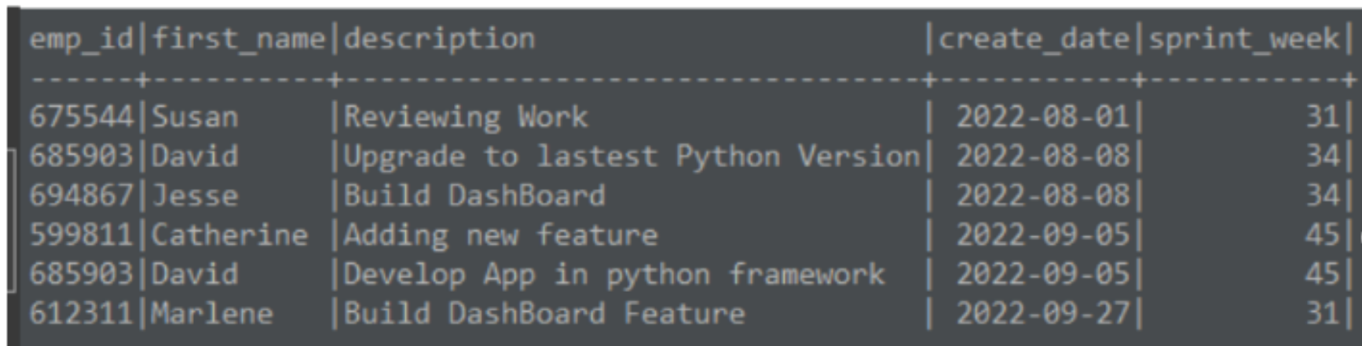
Inquiry 1 - Backlog Tickets
Tickets that are in the product backlog and the scrum masters associated with those tickets
Information on the tickets that are in the backlog.
Helps scrum master to understand the plan for those tickets.
Transparency around the priority items.
Susan is in charge of the ticket ‘Reviewing Work’ which is currently in the backlog. She can make sure to bring it up in standups to discuss with the management and team to decide on the future of that ticket.

Slide 17
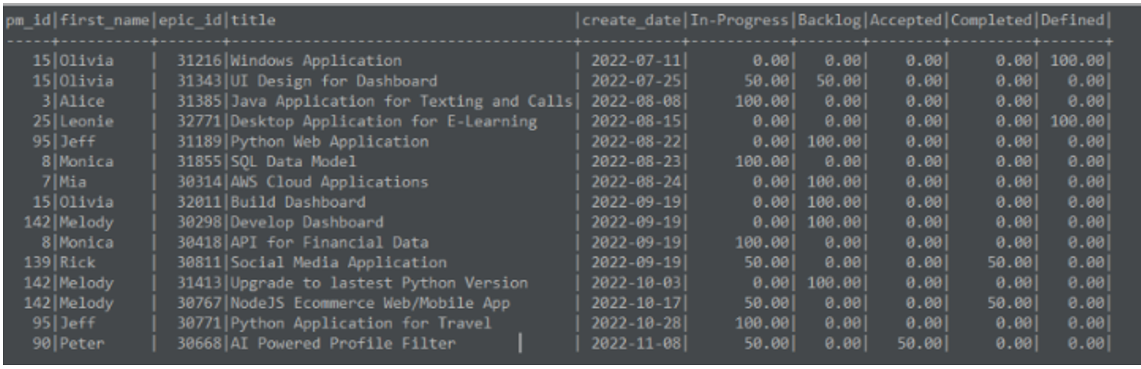
Inquiry 2 - Epics & Tickets
Percentage of tickets of each type under the epics, their details and the information of the associated product manager
Information on the epics created and product manager tracking that particular epic.
Understanding of percentage completion of each epic, to identify the progress of the epic and its related tickets
For ex, Olivia with product manager ID - 15 is in charge of an epic titled ‘Windows Application’ that has 100% tickets in the ‘Defined’ stage.

Slide 18

Thank you!
Questions?

Slide 19
APPENDIX

Slide 20
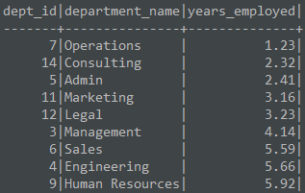
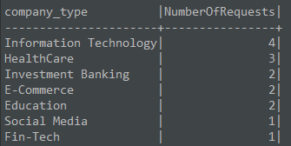
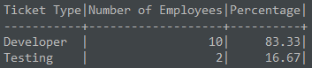
1
2
4

Slide 21
